Slide 1
In your books, create a table of values for the following rule, plot the following points and connect with a smooth line
Rule: y = x² - 1
X | -4 | -3 | -2 | -1 | 0 | 1 | 2 | 3 | 4
y

Slide 2
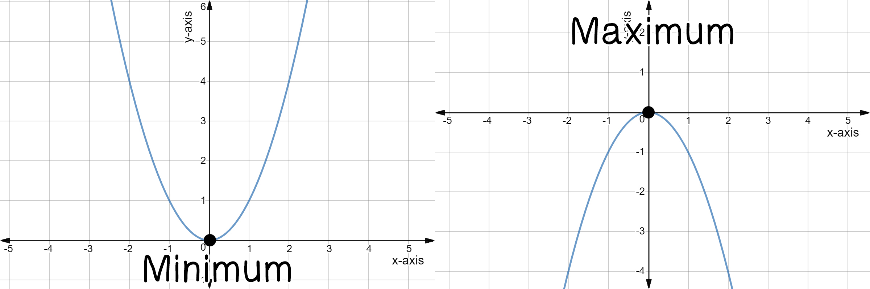
TOPIC: Graphing Parabolas from an equation
EQ: How do I graph parabolas when I’m given a double bracket or an equation?
What are the important points on parabolas?
The minimum, and maximum points are also called the vertex. Through the vertex there is a line of symmetry (the red line).
When graphing a quadratic you need to find the axis of symmetry and pick two points. Either to the left or to the right of the vertex.
Once you found two points you can use the line of symmetry to reflect the other two points

Slide 3

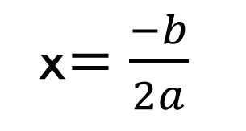

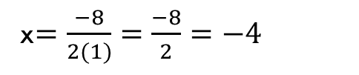

TOPIC: Graphing Parabolas from an equation
EQ: How do I graph parabolas when I’m given a double bracket or an equation?
How do you find axis of symmetry?
x$=\frac{−b}{2a}$
Opposite of b
How do you use the formula?
$$y=ax^{2}+bx+c$$
$$Example: y=x^{2}+8x+12$$
a = 1
b = 8
c = 12
x$=\frac{−8}{2(1)}=\frac{−8}{2}=−4$
So x = $−4$

Slide 4
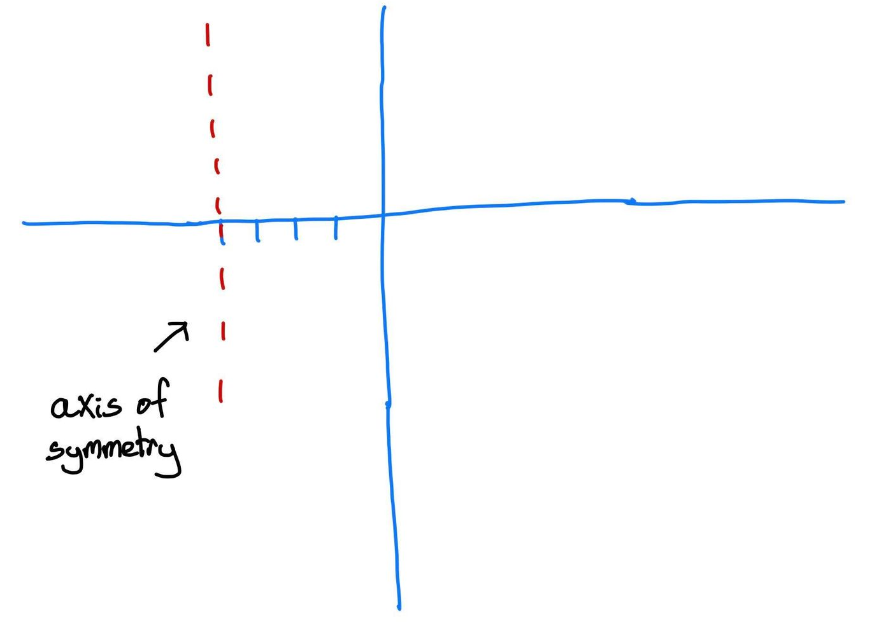
TOPIC: Graphing Parabolas from an equation
EQ: How do I graph parabolas when I’m given a double bracket or an equation?
X | - 4
y
We now know that our coordinate is -4

Slide 5

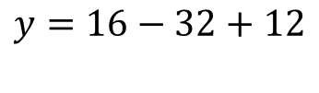
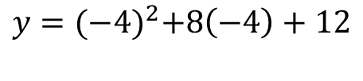
TOPIC: Graphing Parabolas from an equation
EQ: How do I graph parabolas when I’m given a double bracket or an equation?
How do you find the y-coordinate?
X | - 4
y
We now know that our x coordinate is -4
To find the y-coordinate we need to subsitute our x (-4) back into the equation
$$y={(−4)}^{2}+8\left(−4\right)+12$$
$$y=16−32+12$$
$$y=4$$
Is your vertex
X | - 4
y | -4

Slide 6




TOPIC: Graphing Parabolas from an equation
EQ: How do I graph parabolas when I’m given a double bracket or an equation?
How do you find the y-coordinate?
Now you need to pick 2 points either to the left or to the right. In our example we’re picking to points to the right as it is smaller (smaller the easier)!
X | - 4 | -3 | -2
y | 4 | -3 | 0
$$y={(−3)}^{2}+8(−3)+12$$
$$y=9−24+12=−3$$
$$y={(−2)}^{2}+8(−2)+12$$
$$y=4−16+12=0$$

Slide 7
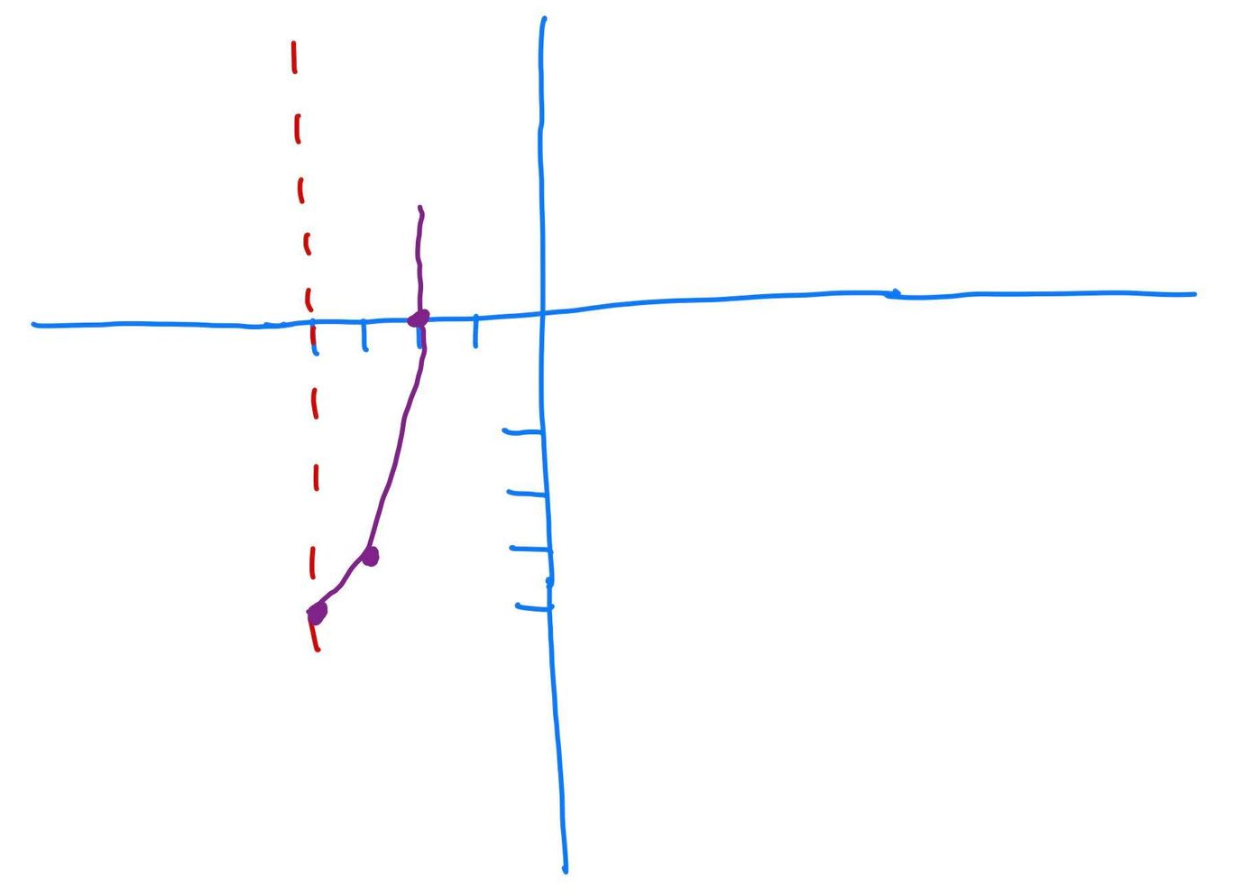
TOPIC: Graphing Parabolas from an equation
EQ: How do I graph parabolas when I’m given a double bracket or an equation?
This point we went over 2 up 4
We went over 1 up 1
We can graph one part of our parabola (the right side). Remember, the points our symmetrical

Slide 8
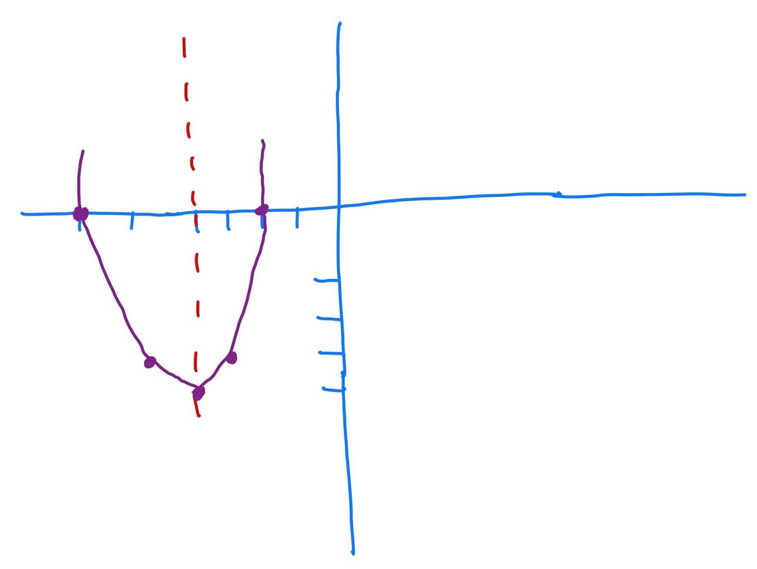
TOPIC: Graphing Parabolas from an equation
EQ: How do I graph parabolas when I’m given a double bracket or an equation?
X | - 4 | -3 | -2
y | 4 | -3 | 0

Slide 9
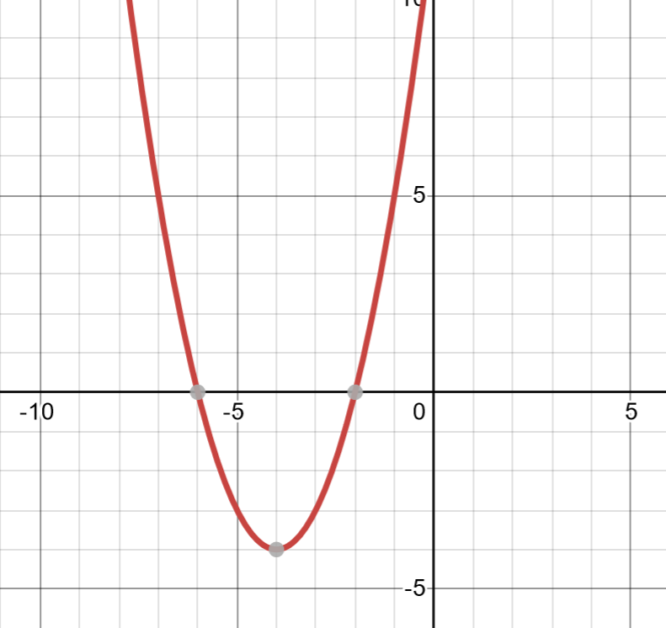

Slide 10


TOPIC: Graphing Parabolas from an equation
EQ: How do I graph parabolas when I’m given a double bracket or an equation?
How to solve double brackets?
$$y=(x+6)(x+6)$$
$$y=x^{2}+12x+36$$
Use the axis of symmetry formula:

Slide 11

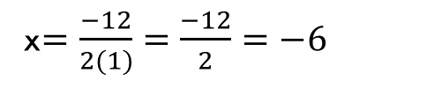
TOPIC: Graphing Parabolas from an equation
EQ: How do I graph parabolas when I’m given a double bracket or an equation?
How to solve double brackets?
$$y=(x+6)(x+6)$$
$$y=x^{2}+12x+36$$
Use the axis of symmetry formula:
x$=\frac{−12}{2(1)}=\frac{−12}{2}=−6$
$$x=−6$$

Slide 12
TOPIC: Graphing Parabolas from an equation
EQ: How do I graph parabolas when I’m given a double bracket or an equation?
$$y=(x+6)(x+6)$$
$$y=x^{2}+12x+36$$
Use the axis of symmetry formula:
x$=\frac{−12}{2(1)}=\frac{−12}{2}=−6$
$$x=−6$$

Slide 13
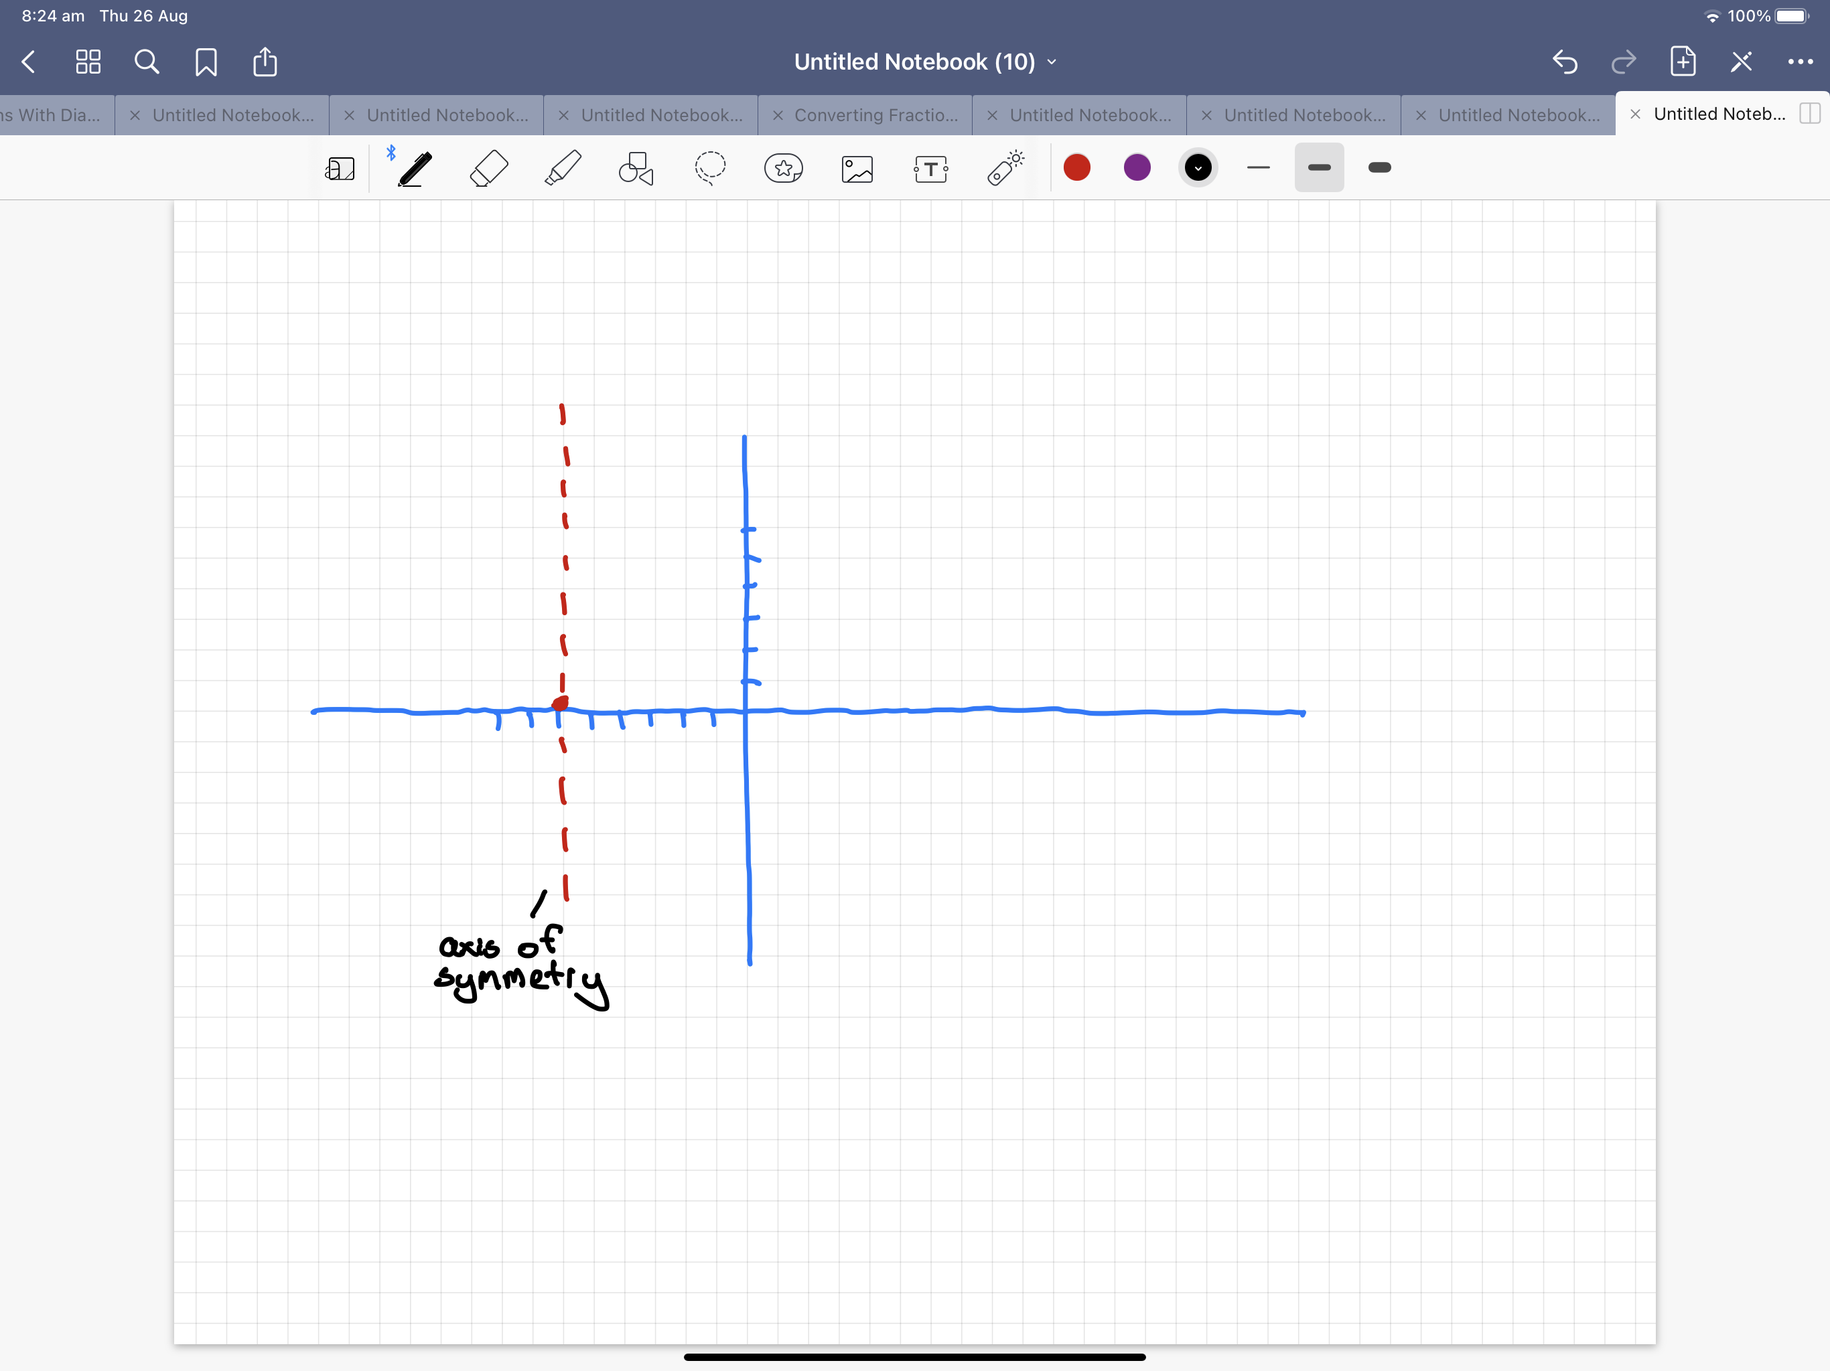
TOPIC: Graphing Parabolas from an equation
EQ: How do I graph parabolas when I’m given a double bracket or an equation?

Slide 14



TOPIC: Graphing Parabolas from an equation
EQ: How do I graph parabolas when I’m given a double bracket or an equation?
To find the y-coordinate substitute our x(-6) back into the equation
$$y={(−6)}^{2}+12(−6)+36$$
$$y=36−72+36$$
This is our vertex
$$y=0$$
x | -6
y | 0

Slide 15




TOPIC: Graphing Parabolas from an equation
EQ: How do I graph parabolas when I’m given a double bracket or an equation?
Now you need to pick 2 points either to the left or to the right. In our example we’re picking two points to the right as it is smaller (smaller the easier)!
x | -6 | -5 | -4
y | 0 | 1 | 4
$$y={(−5)}^{2}+12(−5)+36$$
$$y=25−60+36=1$$
$$y={(−4)}^{2}+12(−4)+36$$
$$y=16−48+36=4$$

Slide 16
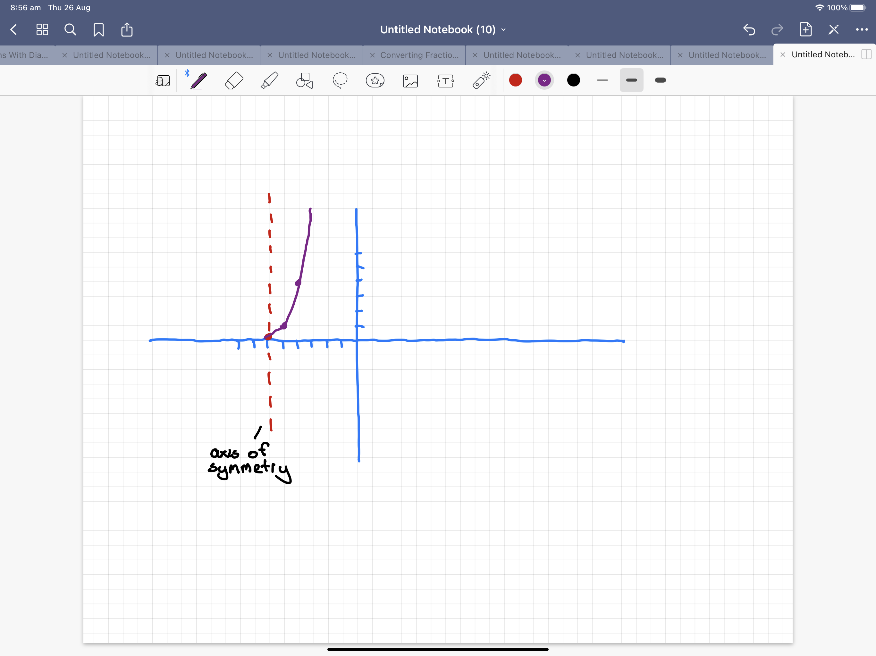
TOPIC: Graphing Parabolas from an equation
EQ: How do I graph parabolas when I’m given a double bracket or an equation?
Over 2 up 4
Over 1 up 1
We can graph one part of our parabola (the right side). Remember, the points our symmetrical

Slide 17
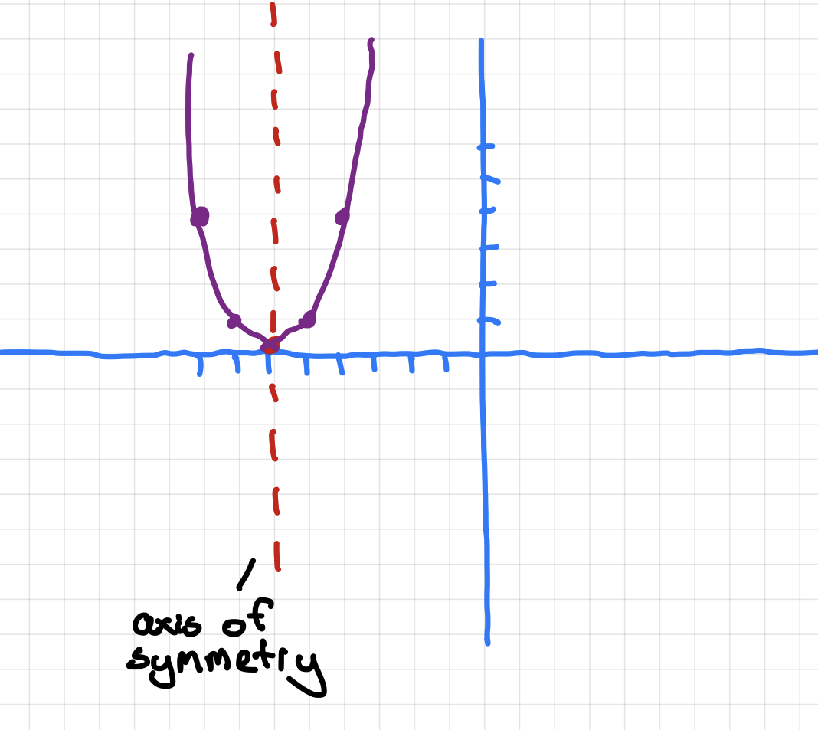
TOPIC: Graphing Parabolas from an equation
EQ: How do I graph parabolas when I’m given a double bracket or an equation?
x | -6 | -5 | -4
y | 0 | 1 | 4

Slide 18
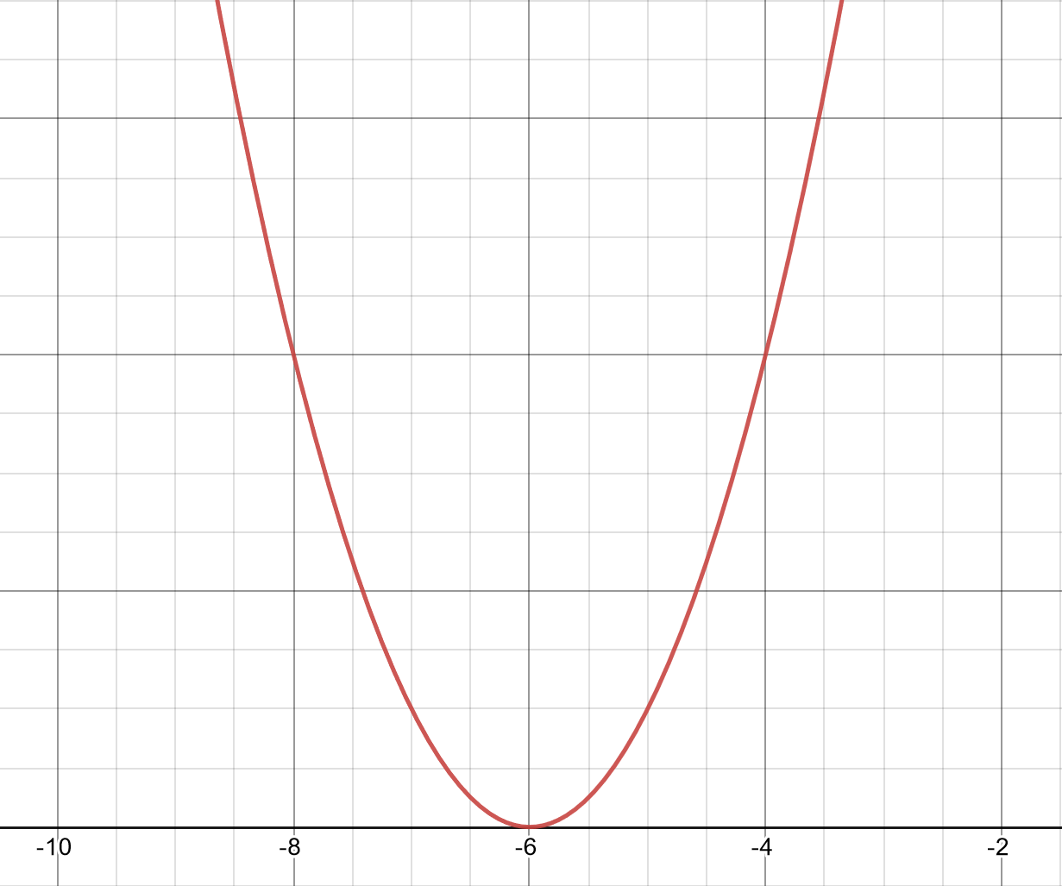

Slide 19
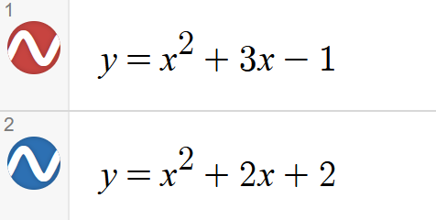
LHS:

